Slide 1
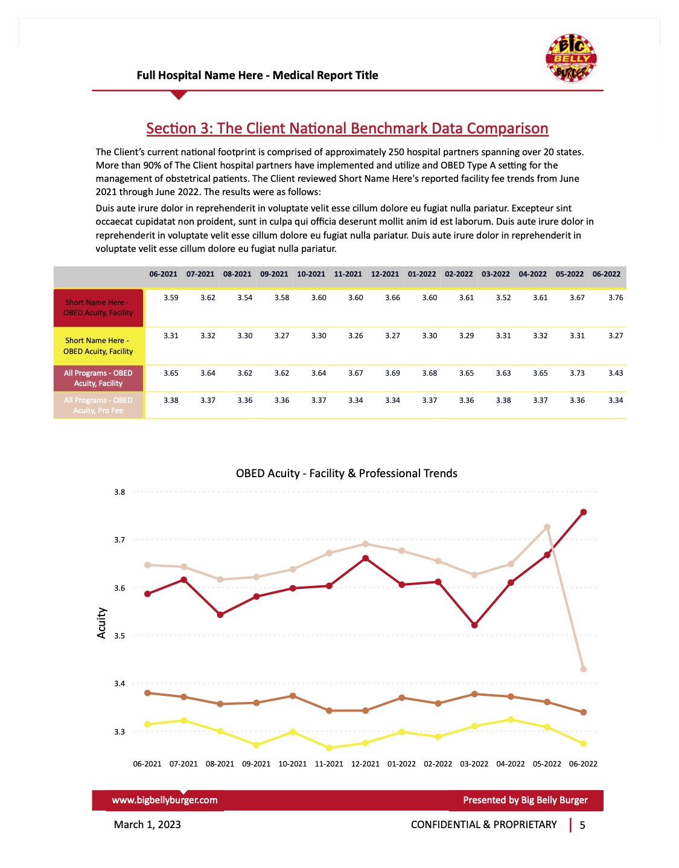




Extract: Excel File in Sharepoint
Load: Power BI
Transform: Power Query
Build Report
Publish App in Power BI Service
Automated Medical Financial Reporting

Slide 2
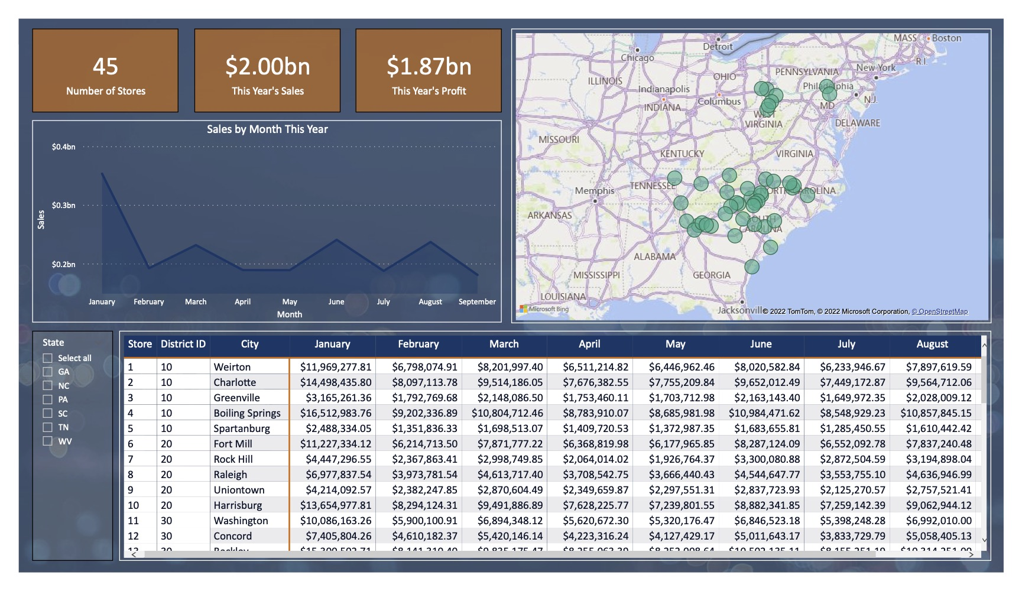
Extract: Excel File in Sharepoint
Load: Power BI
Transform: Power Query
Build Report
Publish App in Power BI Service
Group Case Study Demo

Slide 3
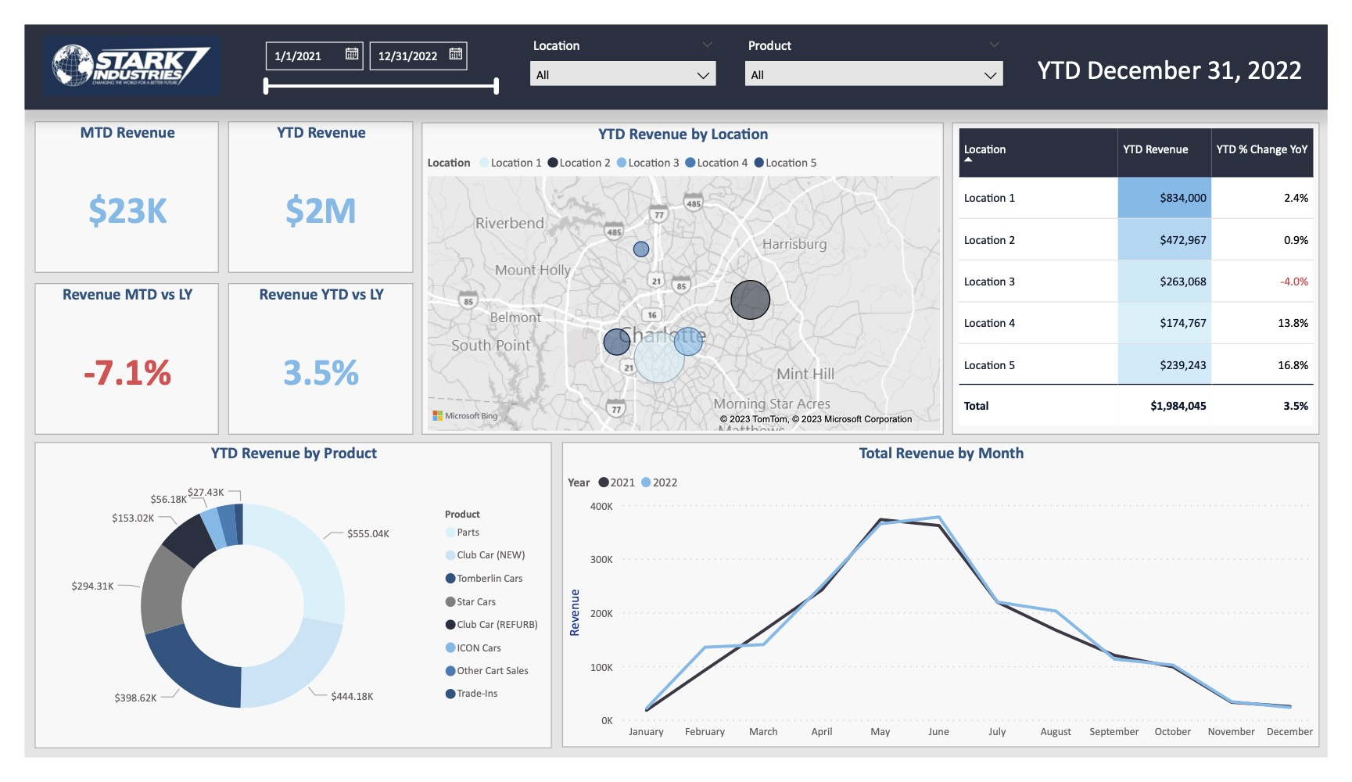
Extract: Excel File in Sharepoint
Load: Power BI
Transform: Power Query
Build Report
Publish App in Power BI Service
Client Proposal Dashboard

Slide 4
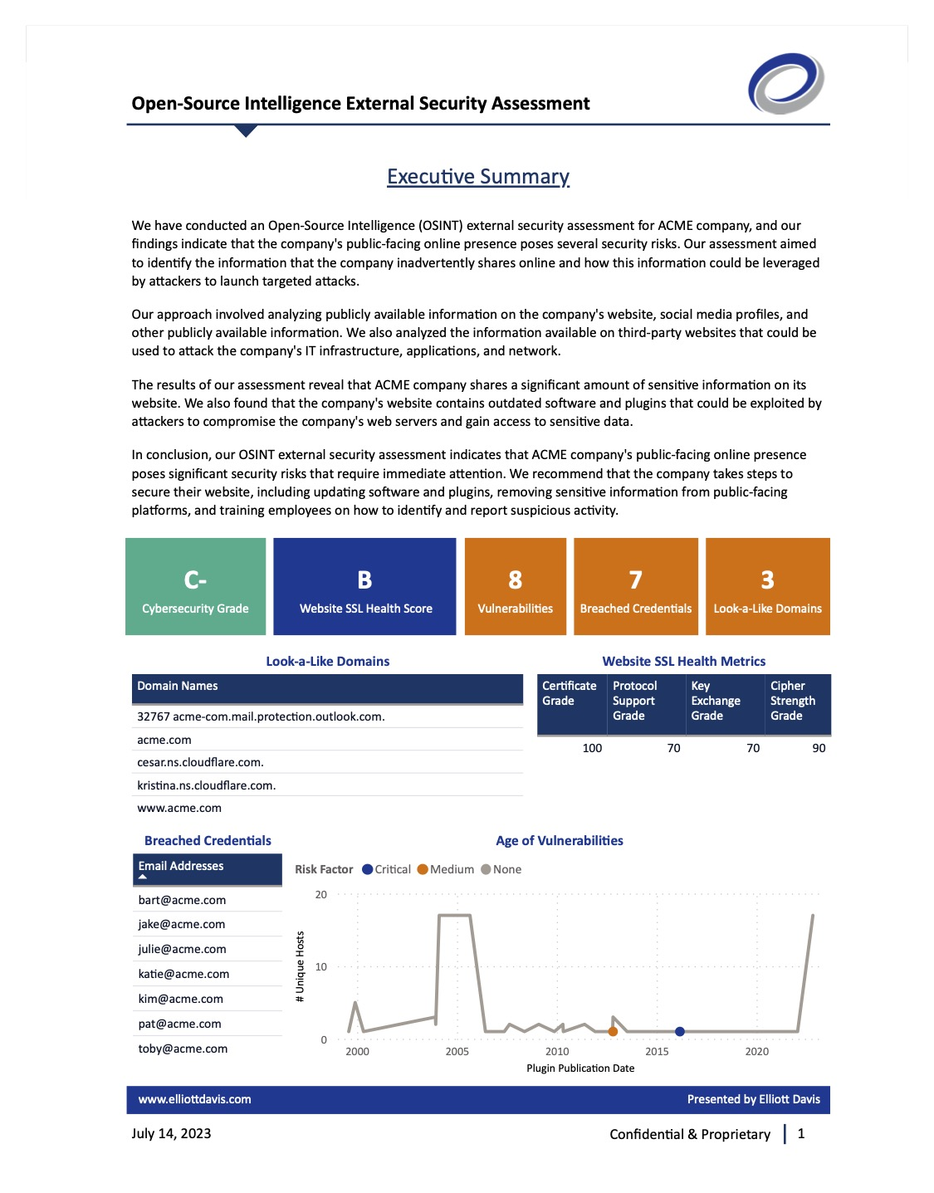
Extract: Excel File in Sharepoint
Load: Power BI
Transform: Power Query
Build Report
Cybersecurity Analytics Report

Slide 5
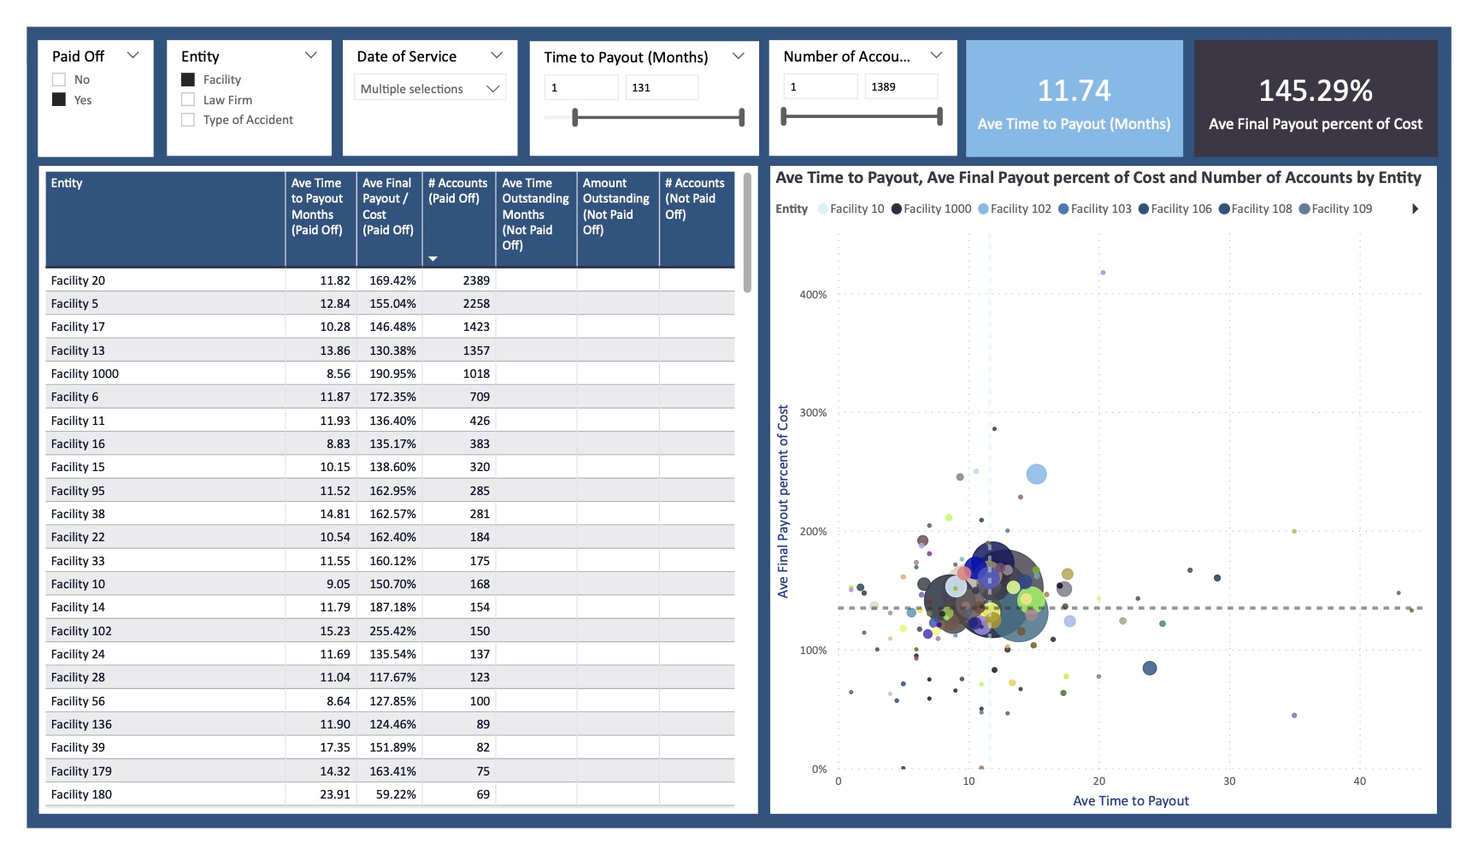
Extract: Excel File in Sharepoint
Load: Power BI
Transform: Power Query
Build Report
Publish App in Power BI Service
Current Client Analytics Demo

Slide 6
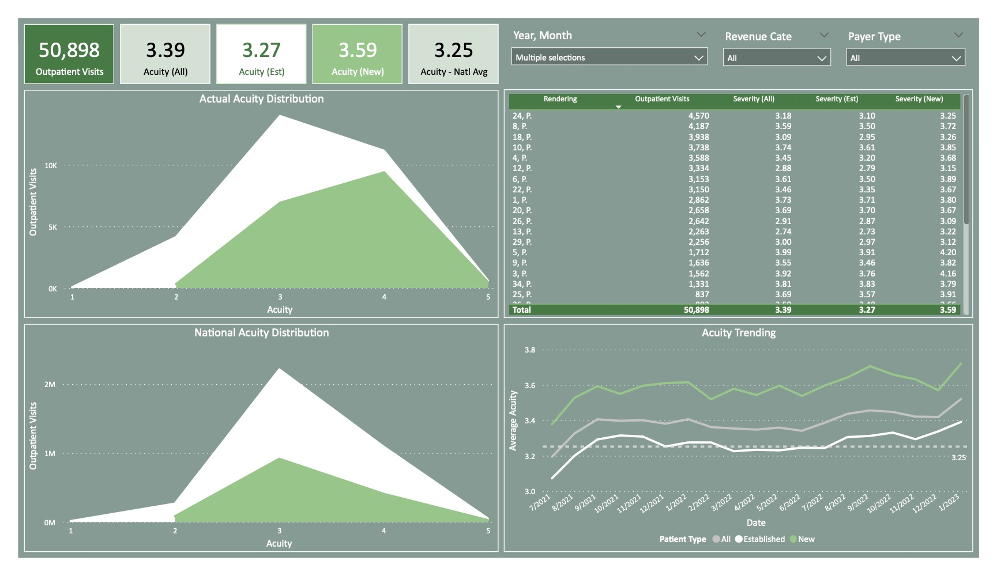
Extract: Excel File in Sharepoint
Load: Power BI
Transform: Power Query
Build Report
Publish App in Power BI Service
Healthcare Ongoing Dashboard

Slide 7
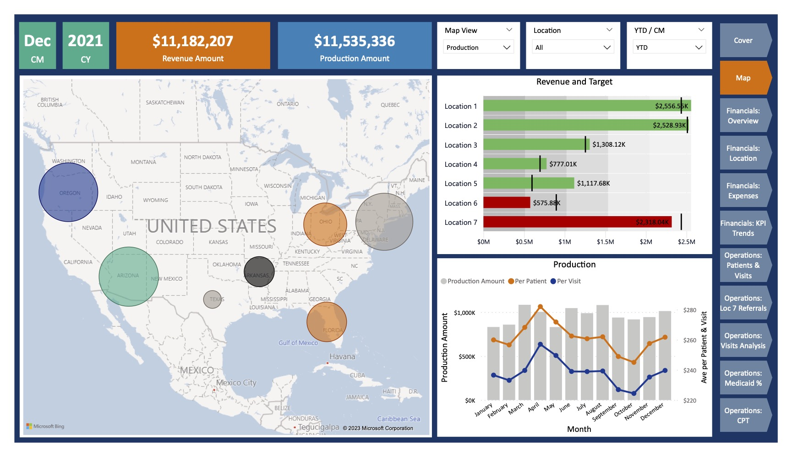
Extract: Excel File in Sharepoint
Load: Power BI
Transform: Power Query
Build Report
Healthcare Practice Demos

Slide 8
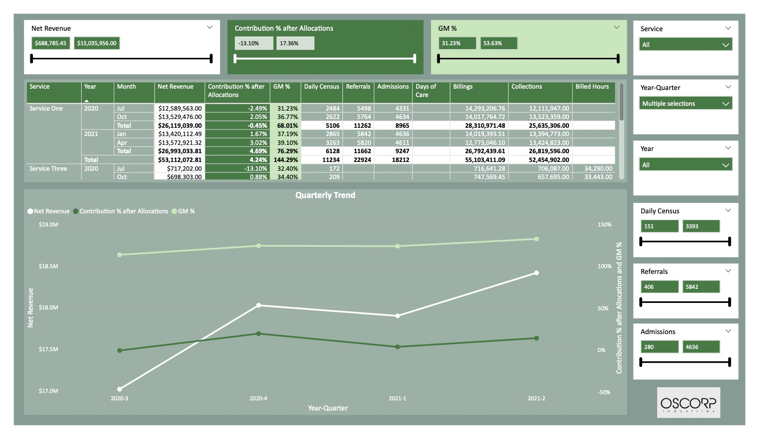
Extract: Excel File in Sharepoint
Load: Power BI
Transform: Power Query
Build Report
Healthcare Proposal Dashboard

Slide 9
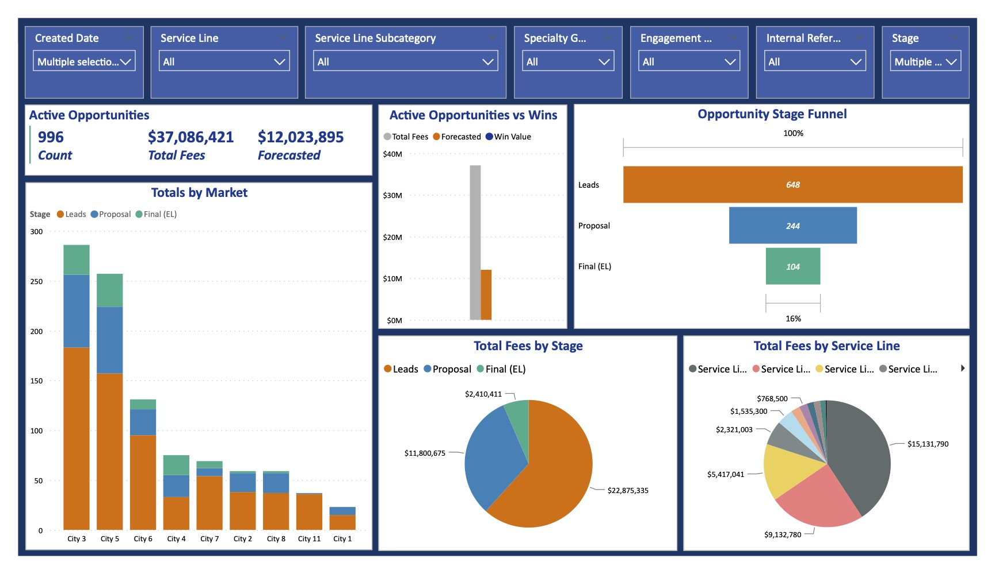

Extract: Smartsheet
Load: Power BI
Transform: Power Query
Build Report
Publish App in Power BI Service
Internal Use Work Tracker

Slide 10
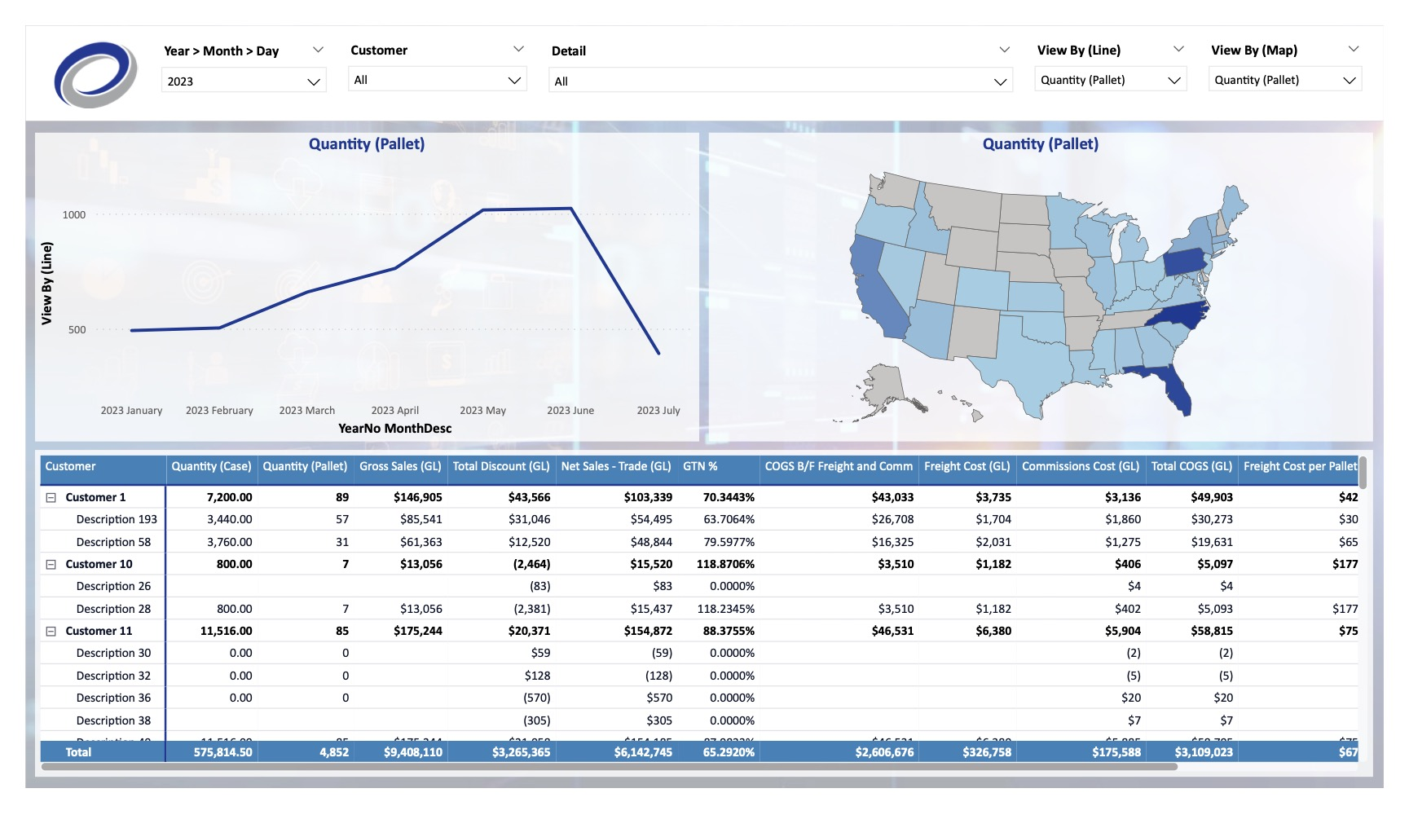

Extract: SQL Database
Load: Power BI
Transform: Power Query
Build Report
Publish App in Power BI Service
Manufacturing Client Demo

Slide 11
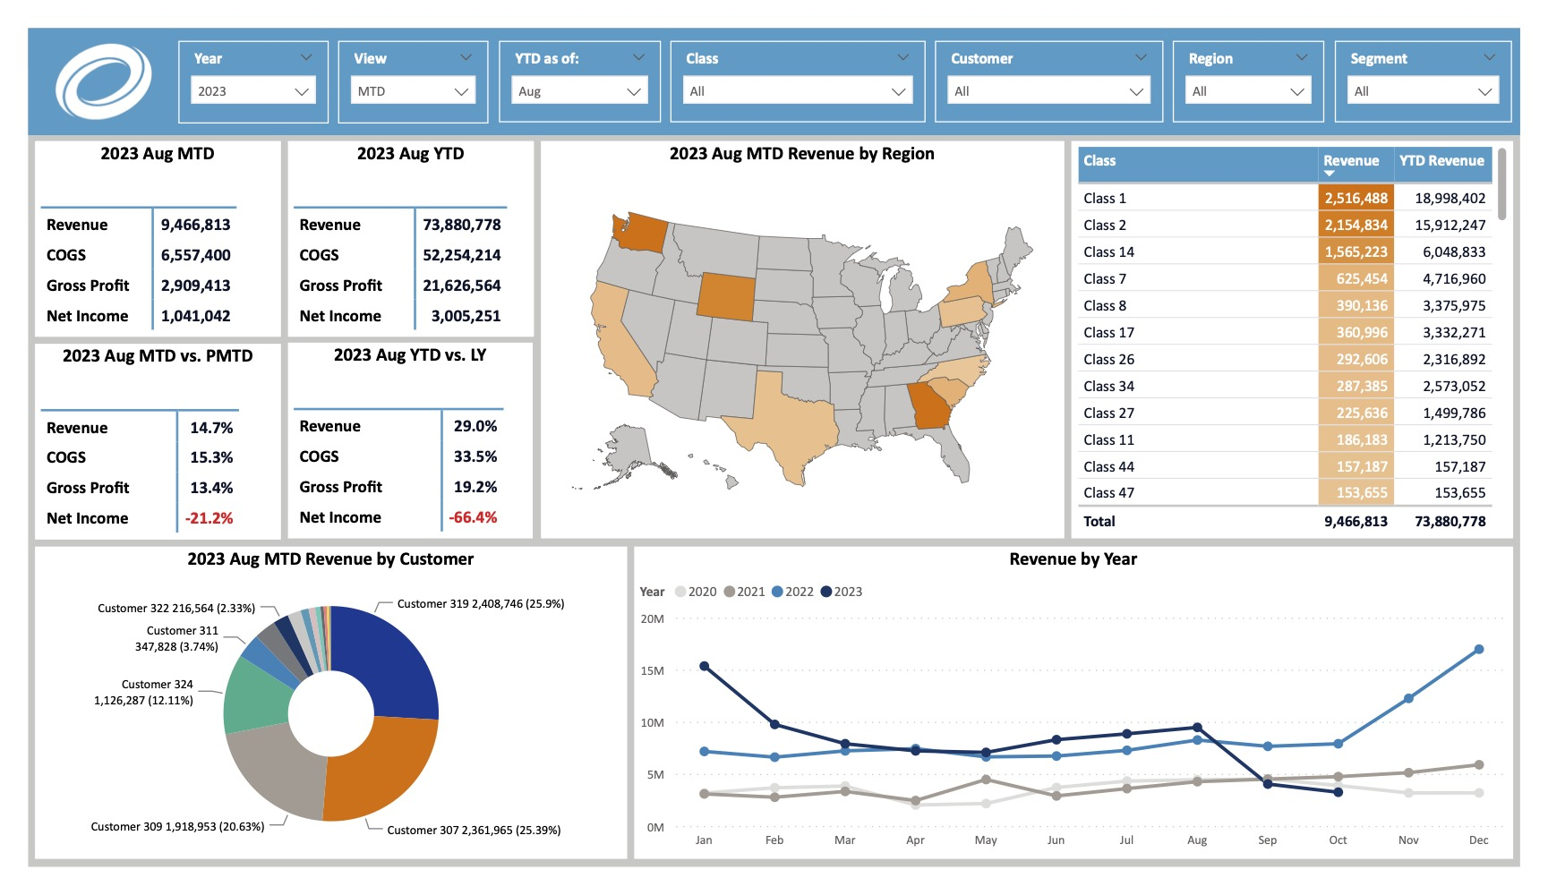

Extract: QuickBooks Online
Load: Power BI
Transform: Power Query
Build Report
Publish App in Power BI Service
Manufacturing QuickBooks Analysis

Slide 12
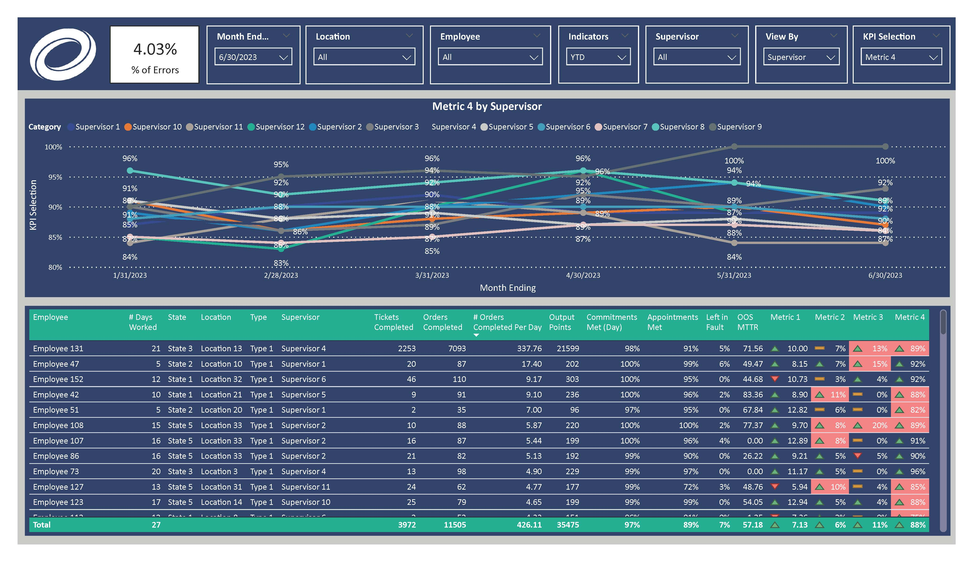
Extract: Excel File in Sharepoint
Load: Power BI
Transform: Power Query
Build Report
Publish App in Power BI Service
Manufacturing Supervisor Dashboards

Slide 13
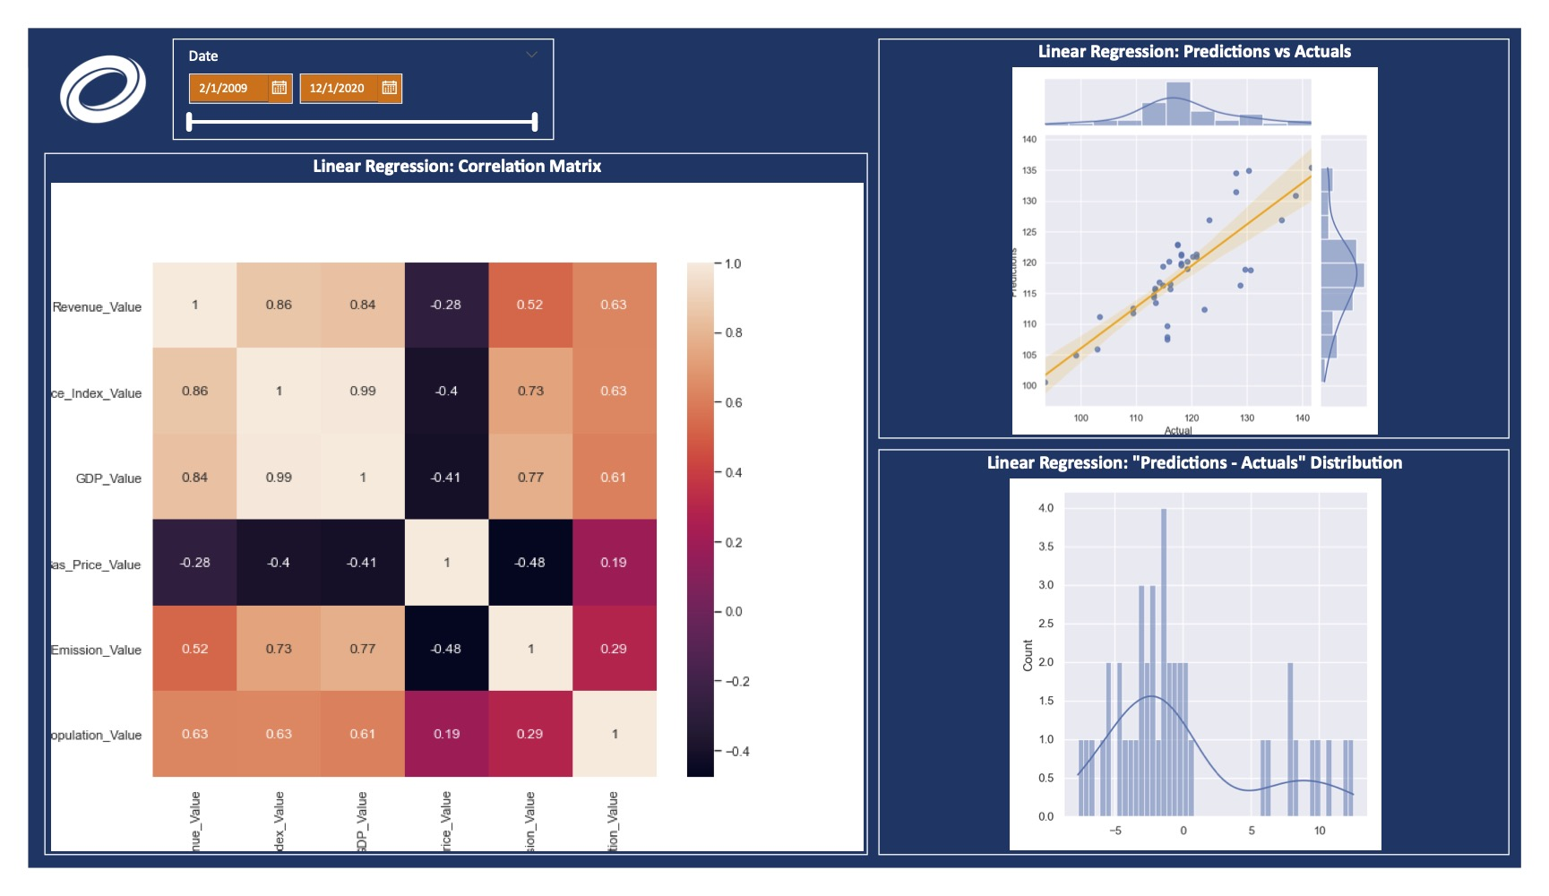

Extract: APIs and Web Scraping with Python
Load: Power BI
Transform: Power Query
Build Report
Extract: Excel File
Power BI + Python + Machine Learning Forecasting

Slide 14
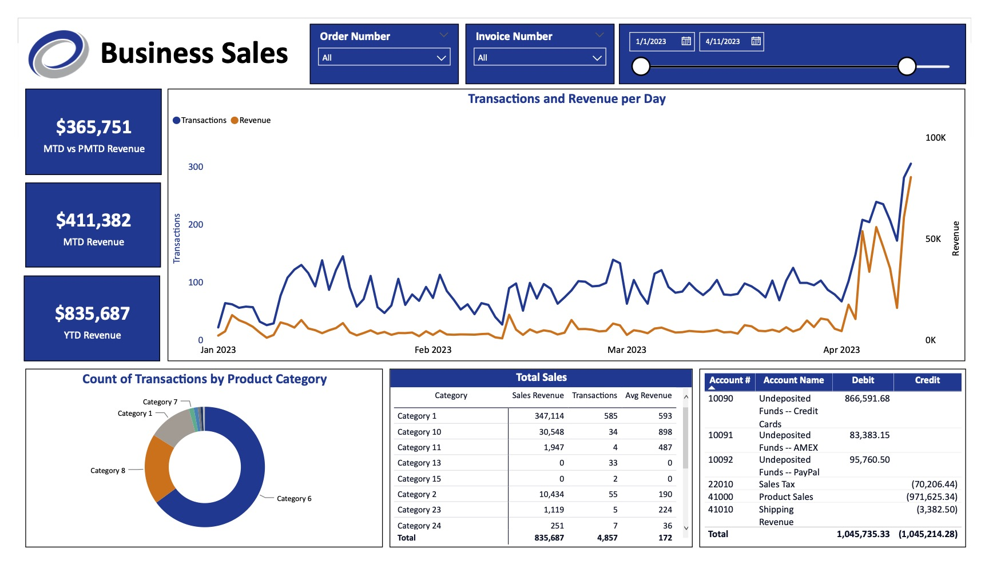

Extract: AWS S3
Load: Power BI
Transform: Power Query
Build Report
Publish App in Power BI Service
Webinar Part 1

Slide 15
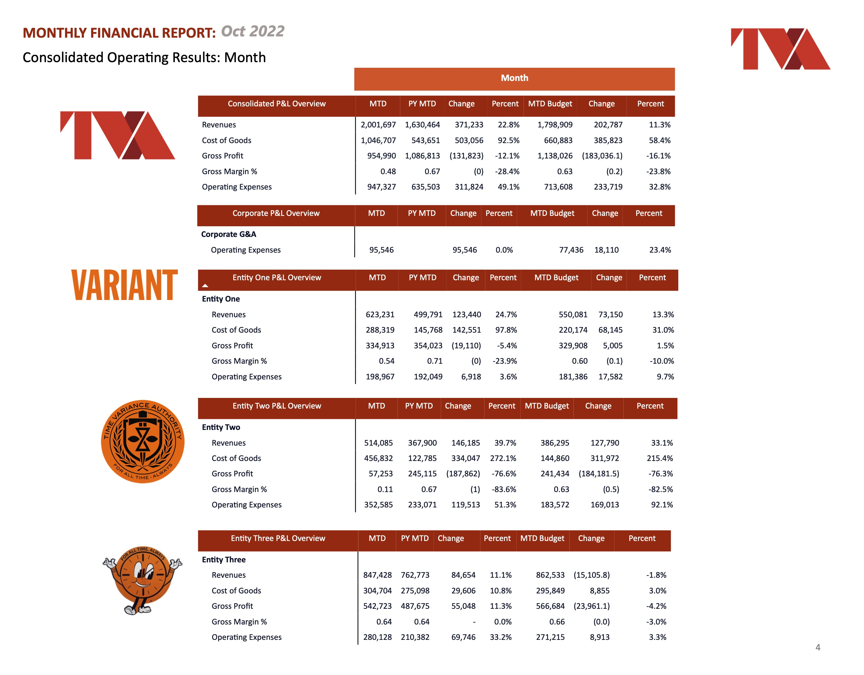
Extract: Excel File in Sharepoint
Load: Power BI
Transform: Power Query
Build Report
Private Equity Financial Reporting Automation

